Slide 1

Welcome
To
Object-Oriented
Programming

Slide 2
Lecture 1: Course Guide
Module Code: 301 ST, 1301 ST,1303 FST, 1303 ST, 1204 FST, 1303 FST
Module Name: Object-Oriented Programming
BAZIGU ALEX

Slide 3
Instructor
BAZIGU ALEX
VU email: abazigu@vu.ac.ug
Ind Email: azigu.alex@gmail.com
TEL
+256 (0)772098106
+256 (0)704923822

Slide 4
Course Details
Module Code: 1204 ST, 1303 FST
Module Name: Object-Oriented Programming
Previously (Programming Methodology II)
3 hours of lecture
2 hours of lab sessions (time and venue to be communicated) but majorly Computer Lab Level 6
Student expected to spend 4 hours practicing
Course Prerequisites
Computer Literacy
Programming Fundamentals

Slide 5
Course Objectives
The course is to give an in depth understanding of Object Oriented programming.
Move the students programming skills from basic to advanced.
Avail students with skills to handle non-functional program aspects like robustness and security
Train students to develop complete software applications

Slide 6
Course Outline
The Object Oriented programming paradigm.
Classes and Objects
Inheritance and visibility modifiers
Interfaces and abstract classes
Graphical user interfaces and action handlers
Exception handling
Working with files and databases
Sessions and user management

Slide 7
Assessment Style
Tests and programming assignments (40%)
Practical Examination (30%)
Written Examination (30%)

Slide 8
Reading References
Java Software Solution: Foundations of Program Design by John Lewis and William Loftus
Introduction to Java Programming byY. Daniel Liang
Internet Resources
e.g., Java Tutorials by Oracle
http://docs.oracle.com/javase/tutorial/

Slide 9
Course Rules
Classes are compulsory (attendance & participation = 5 marks)
No phone usage allowed during class time
Time keeping is a must
No movements in & out of class | breaks will be provided
Work together but write own code - No Xeroxing friends work

Slide 10
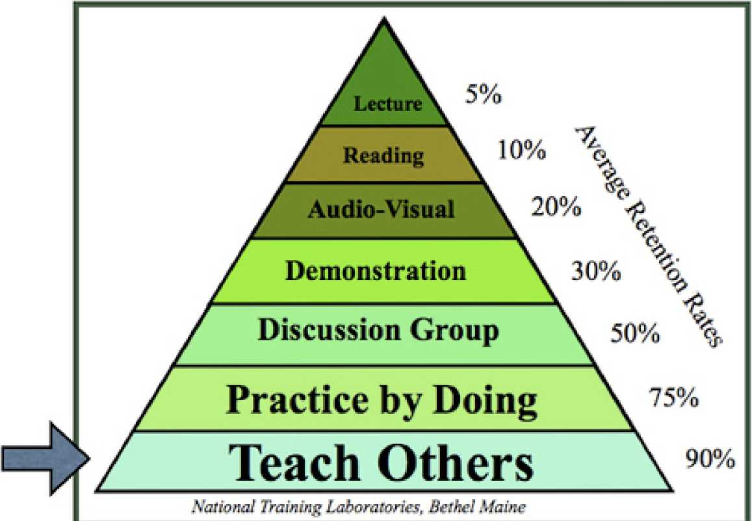
Teaching & Learning Pattern
The Learning pyramid

Slide 11


Slide 12
Lecture I: Introduction (2)
Object-Oriented Programming
BAZIGU ALEX

Slide 13
Focus of the Course
Object-Oriented Software Development
problem solving
program design, implementation, and testing
object-oriented concepts
classes
objects
encapsulation
inheritance
polymorphism
graphical user interfaces
the Java programming language

